Slide 1
Profit-making in state-funded & private pay home care in Ontario: implications for quality care & quality work
Cynthia Cranford
University of Toronto, Department of Sociology
c.cranford@utoronto.ca
Care Economy Webinar
"Risky Business: Profitizing Home Care"
April 3, 2025

Slide 2
Profit making & social reproduction
Extended framework of social reproduction for long-term aging care & disability support
  marketization
  corporatization & financialization
https://towardsjustcare.com/home-care-toolkit/
  through the privatization of costs?
Implications

Slide 3

Social organization of home care
Intersecting axes of oppression
Organization of work & employment
Tensions between & alliances for quality care & quality work
Cornell University ILR Press
cornellpress.cornell.edu

Slide 4
Fault lines & everyday tensions: ON public-funded home care
        State Funding social/medical
Gendered, Racialized Labor Market
non-profit/profit delivery
secure / precarious contracts
Unions Senior & Disability
Social Movements & Orgs.
Labor Process
management
gendered, racialized,
aged & disabling tensions
unrecognized/mediated
care receivers care workers
Employer associations
Non-profit /profit

Slide 5
Comparative case study analysis
Care/Support Delivery Funding | Individualized, Direct Funding (TO, ON) | Non-Profit Contract Agency (TO, ON) | For-Profit Contract Agency (TO, ON) | Individualized-State Hybrid (LA, Bay, SB, California) | Organizations delivering on the privatization of cost
-Provincially ‘universal’ -Social IL | Self Managed: disability support, heterogeneous women workers | Attendant Services: disability support, immigrant women & men workers
-Means-tested -Social IL |  |  |  | IHSS: disability & aging, immigrant &/or women of colour workers
-Provincially ‘universal’, -Medical |  |  | Home Care: aging, immigrant women workers
Private Pay |  |  |  |  | Aging & disability support, *migrant workers?

Slide 6
Private pay home care types: ownership * work org
Ownership Organization of Work/who is employer? | For-profit sole proprietor | For-profit corporation financialized | Non-profit | Co-op | Domestic work
Direct Care Service Provider | likely | ? | ?
Franchise |  | yes
Franchisee | yes | ?
Temporary agency |  | ?
Recruitment agency |  | ? |  |  | yes
Platform |  | ? |  |  | yes
Care Receiver |  |  |  | ? | yes
Care Worker |  |  |  | yes

Slide 7
Fault lines & everyday tensions: private pay home care?
        State
Private pay
Gendered, Racialized Labor Market
for-profit: more corporatized, financialized
more precarious contracts
Migrant Labour Intersectional Feminist,
Social Movement & Orgs Disability Justice, ?other
Labor Process
management
gendered, racialized,
aged & disabling tensions
exacerbated?
care receivers care workers
Employer associations
For-profit (corporate)

Slide 8
Democratic Labor-Community Alliances
A Universal Social Funding Model
Labour Process Tensions Recognized and Negotiated
Culturally Sensitive, Funded, Labour Market Intermediaries
Intimate community unionism

Slide 9
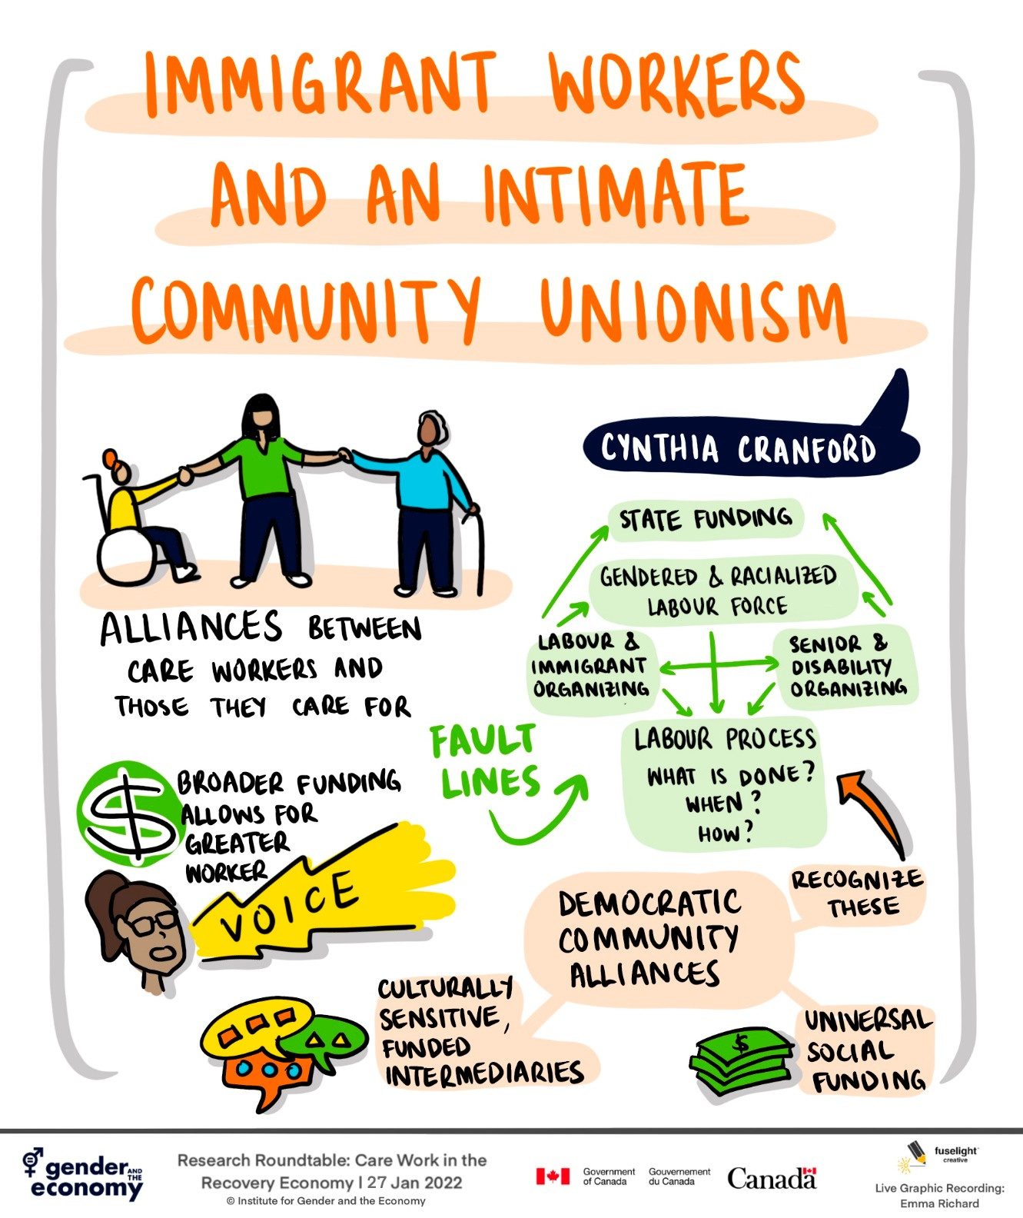

Slide 10
Select Bibliography
Armstrong, Pat, and Hugh Armstrong, editors. 2020. The Privatization of Care: The Case of Nursing Homes. London: Routledge.
Aronson, Jane, and Sheila M. Neysmith. 1996. “‘You’re Not Just in There to Do the Work’: Depersonalizing Policies and the Exploitation of Home Care Workers’ Labor.” Gender and Society 10 (1): 59–77.
Boris, Eileen, and Jennifer Klein. 2015. Caring for America: Home Health Workers in the Shadow of the Welfare State. Oxford: Oxford University Press.
Cobble, Dorothy Sue. 2010. “More Intimate Unions.” Pp. 280–96 in Intimate Labors: Cultures, Technologies and the Politics of Care, edited by Eileen Boris and Rhacel Salazar Parreñas. Stanford: Stanford University Press.
Collins, Patricia Hill. 2002. Black Feminist Thought: Knowledge, Consciousness, and the Politics of Empowerment. 2nd ed. London: Routledge.
Farris, Sara F. Amy Horton and Eva Lloyd. 2024. “Corporatisation and Financialization of Social Reproduction: Care Homes and Childcare in the United Kingdom.” Environment and Planning F.
Glenn, Evelyn Nakano. 2010. Forced to Care: Coercion and Caregiving in in America. Harvard: Harvard University Press.
Grant, Karen R., Carol Amaratunga, Pat Armstrong, Madeline Boscoe, Ann Pederson and Kay Wilson Aronson, Jane, editors. 2004. Caring For/Caring About: Women, Home Care and Unpaid Caregiving. Aurora, Ont.: Garamond Press.
Kelly, Christine. 2016. Disability Politics and Care: The Challenge of Direct Funding. Vancouver: University of British Columbia Press.
Parreñas, Rhacel Salazar. 2015. Servants of Globalization: Women, Migration, and Domestic Work, 2nd Edition. Stanford: Stanford University Press.
Tronto, Joan. 2013. Caring Democracy: Markets, Equality and Justice. New York: New York University Press.
Williams, Fiona, and Deborah Brennan. 2012. “Care, Markets and Migration in a Globalising World: Introduction to the Special Issue.” Journal of European Social Policy 22 (4): 355–62.

