Slide 1
Home-care supplies crisis in Ontario
A Reporter’s Perspective
Kenyon Wallace, Toronto Star
The Care Economy Webinar
April 3, 2025

Slide 2
Who am I?
Business reporter at the Toronto Star
Previously spent five years a health reporter covering the COVID-19 pandemic (stories of interest for me included how privately owned long-term-care homes had higher death rates than municipal homes or non-profits)
Prior to this was a member of the Star’s investigations team for 8 years
Have been a reporter for 17 years

Slide 3
What happened?
In September 2024, home-care patients and their caregivers began to notice that shipments of medical supplies to their homes were delayed, arriving incomplete or not showing up at all – things like bandages, gauze, catheter bags and tubes
Doctors also reported that they were having trouble accessing specialized equipment and medications, such as pain pumps, drainage bags, syringes, pain-relief drugs and even complete medical-assistance-in-dying (MAID) kits — supplies that are crucial for ensuring patients who want to die at home can do so in comfort and with dignity.
The problems coincided with changes to provincial contracts with companies that procure supplies and fulfil deliveries in late September.

Slide 4
What happened?
Patients and their caregivers began to complain to the provincial agency that is responsible for home care: Ontario Heath atHome, which is overseen by Ontario Health.
When they did not get satisfaction, they began reaching out to the media, such as myself and Hamilton Spectator reporter Joanna Frketich
We began to write about patients’ experiences

Slide 5
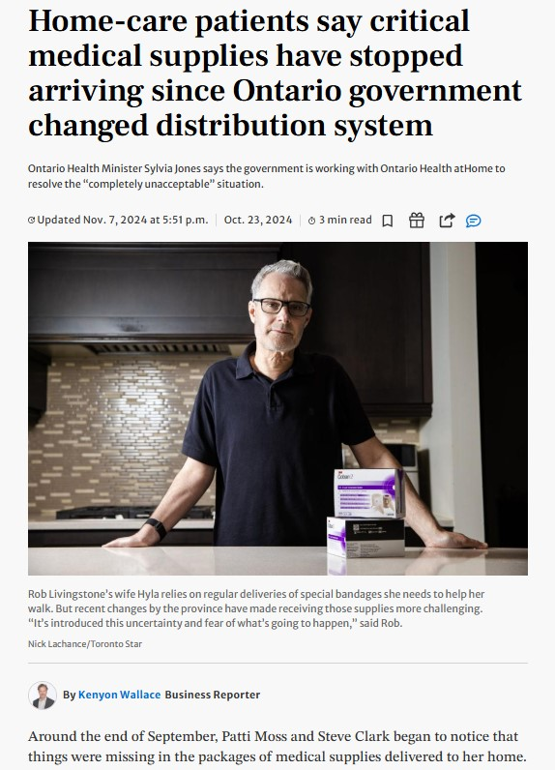
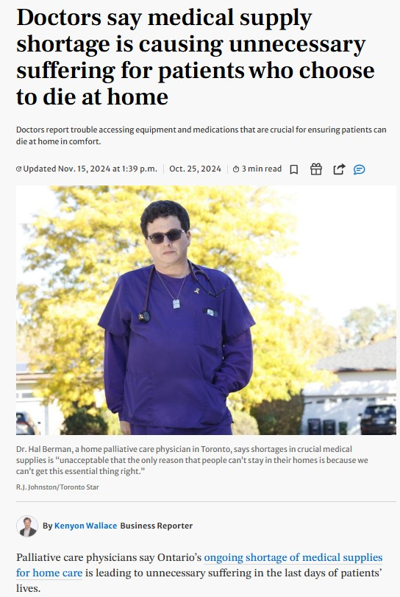
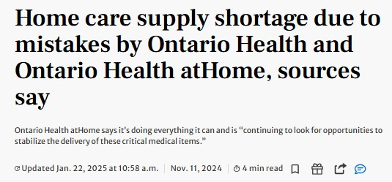
Examples of stories

Slide 6
Sources speak up
Sources who spoke to me said the shortage stemmed from three problems introduced when Ontario Health and Ontario Health atHome changed the way supplies reach thousands of patients receiving care at home
The first: Formulary of medical supplies and medications needed for home care wasn’t finalized until just before the new procurement and distribution system launched in September;
The second: forecasts for quantities of supplies set by the provincial agencies were too low to meet demand;
The third: a consolidation of private supply companies resulted in fewer suppliers being responsible for larger geographic areas, which contributed to logistical and delivery delays.

Slide 7
What did the province say?
Ontario Health atHome told the Star it launched new contracts for medical equipment and supplies because the previous contracts were expiring. This provided an opportunity, the agency said, “to provide better access to standardized high-quality products across the province.”
Ontario Health, which sources say issued requests-for-bids to supply vendors, did not respond to a request for comment.
Another issue: the quantities of supplies on the new formulary were much lower and not nearly enough to service all of Ontario’s home-care patients.
The previous formulary contained some 2,000 items, many of which were duplicates to ensure supply would not be disrupted if a manufacturer went down or supply chains were disrupted, according to sources. But the new formulary had only around 700 items, meaning there was no redundancy built in.

Slide 8
So who are the companies involved?
Under previous contracts, local businesses, such as pharmacies and smaller medical supply companies, serviced areas that roughly lined up with the province’s 14 former Local Health Integration Networks (LHINs).
The new structure now has two master service providers, both private companies, Cardinal Health and Ontario Medical Supply (OMS), that procure supplies on the open market, with four companies — OMS, Bayshore Specialty Rx, Shoppers Drug Mart and Robinsons — responsible for distribution to patients.
Cardinal Health is an American multinational health care services company with more than 30 per cent of shares owned by some of the world’s largest private equity and institutional investors.
Only Bayshore responded to my requests for comment.
Getting transparency out of these companies and the government was almost impossible. Had it not been for sources who spoke to me on the condition of anonymity, I would not have been able to report what I did.

Slide 9
What did insiders say?
Brett Geneau, a representative of CUPE, which has about 1,800 members at Ontario Health atHome, told me the home-care medical supply problems are a symptom of a massive restructuring of Ontario’s 14 former LHINs into Ontario Health atHome that began in 2023 to oversee all in-home and community-based care across the province.
Geneau, who works as a team assistant for Ontario Health atHome, said the agency has been in “chaos” since the first week the supply system was changed.

Slide 10
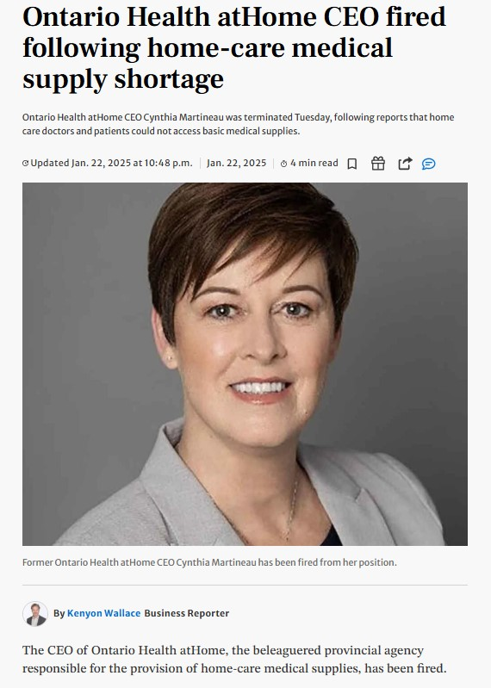
What was the fallout?
In late January 2025, the Ontario government fired Ontario Health atHome’s CEO.
“Cynthia Martineau is no longer with Ontario Health atHome,” the agency said in a statement to the Star.
“We understand how vitally important home and community care is to families across the province. That is why, together with our partners, we will continue to take action to improve the delivery of high-quality, accessible and connected care.”

Slide 11
Questions?

